Slide 1
Samsung
Innovation
Campus
Deep Learning Project

Slide 2

Plant Disease Classification
Using New Plant Diseases Dataset
By: Youssef Abdel Mottaleb & Ahmed Gomaa
Org: Samsung Innovation Campus
Supervised By: Dr/ Shady Nagy
Facilitator: Eng.Ali Hamed

Slide 3

Team Members
Youssef Abdel Mottaleb
Abdel Aziz
Ahmed Gomaa

Slide 4
Agenda
The Following Topics will be discussed:
Introduction
Motivation
Data Exploration
Data Preprocessing
Modelling and Evaluation
Problem and Solution
Deployment

Slide 5
Introduction
The Plant Disease Dataset consists of about 87K RGB images of healthy and diseased
crop leaves which is categorized into 38 different classes. The total dataset is divided into 80/20 ratio of training and validation set preserving the directory structure. A new directory containing 33 test images is created later for prediction purpose.
Dataset Information:
We have 38 classes of plant disease images which contains 70295 images in training set and 17572 in valid set
Each class contains average of 1700-1800 number of images to work upon
Each image is of size= (256,256,3)

Slide 6
Motivation
The human population is expected to reach 9.6 billion by 2050 and this will result in increased demands for food. It has been estimated that the global food supply may need to grow by as much as 70% in order to meet these demands (UN, 2013). For such growth, it has been predicted that crop supply may have to increase as much as 80–110% (Ray et al., 2013). To achieve these yields, the impact of crop disease must be reduced. It has been estimated that at least 10% of global food production is lost to plant diseases
But How Can We Solve Such a Problem Like That ?
and How Can We Reduce The Diseases as much as we can ?

Slide 7
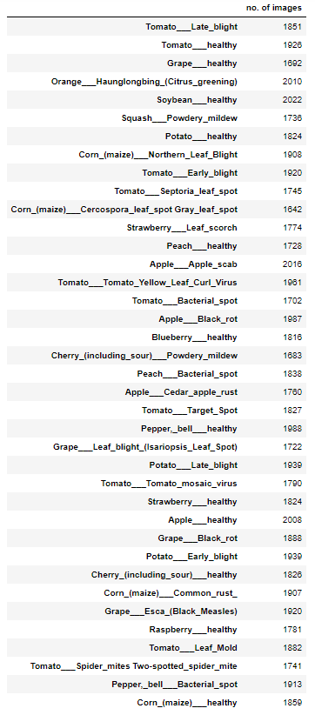
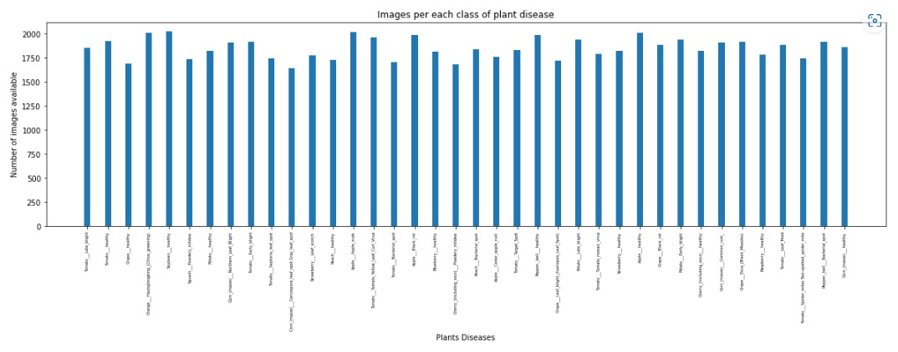
Data Exploration & Preprocessing and
Dataset consists of 87K RGB images of healthy and diseased crop leaves which is categorized into 38 different classes.

Slide 8
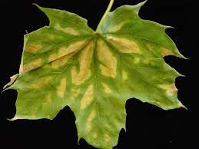
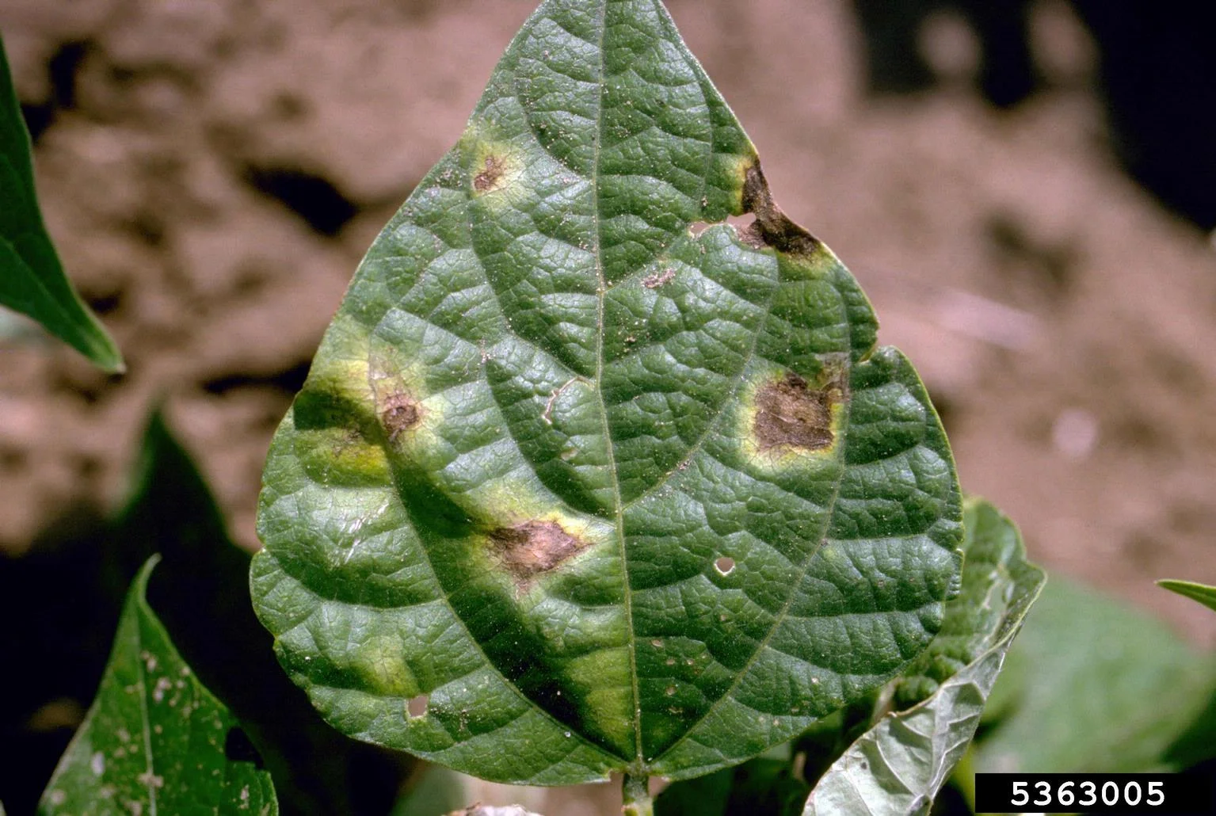
Data Exploration & Preprocessing and
Most plant diseases – around 85 percent – are caused by fungal or fungal-like organisms.
A sign of plant disease is physical evidence of the pathogen. For example, fungal fruiting bodies are a sign of disease.
A symptom of plant disease is a visible effect of disease on the plant. Symptoms may include a detectable change in color, shape or function of the plant as it responds to the pathogen. Leaf wilting is a typical symptom of verticilium wilt, caused by the fungal plant pathogens ,Verticillium albo-atrum and V. dahliae. Common bacterial blight symptoms include brown, necrotic lesions surrounded by a bright yellow halo at the leaf margin or interior of the leaf

Slide 9
Data Exploration & Preprocessing and
Here are a few examples of common signs and symptoms of fungal, bacterial and viral plant diseases:
Fungal disease signs:
Leaf rust (common leaf rust in corn)
Stem rust (wheat stem rust)
Sclerotinia (white mold)
Powdery mildew
Fungal disease symptoms:
Birds-eye spot on berries (anthracnose)
Damping off of seedlings (phytophthora)
Leaf spot (septoria brown spot)
Chlorosis (yellowing of leaves)
Bacterial disease signs (difficult to observe, but can include):
Bacterial ooze
Water-soaked lesions
Bacterial streaming in water from a cut stem
Bacterial disease symptoms:
Leaf spot with yellow halo
Fruit spot
Canker
Crown gall
Viral disease signs:
None – the viruses themselves can’t be seen
Viral disease symptoms:
Mosaic leaf pattern
Crinkled leaves
Yellowed leaves
Plant stunting

Slide 10
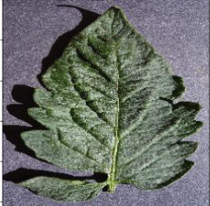
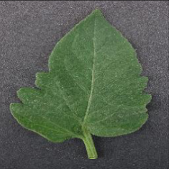
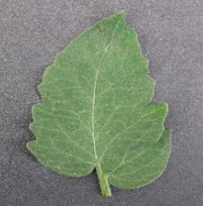
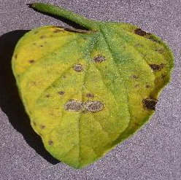
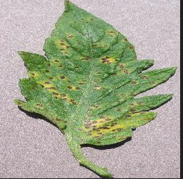
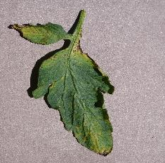
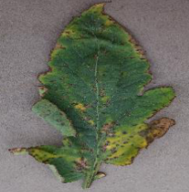
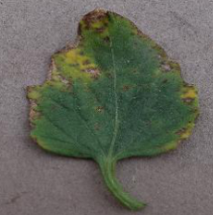
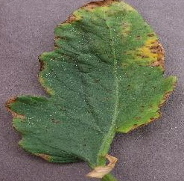
Data Exploration and Preprocessing
Effect of some diseases on Tomato
Healthy:
Septorial Leaf Spot :
Bacterial Spot :

Slide 11
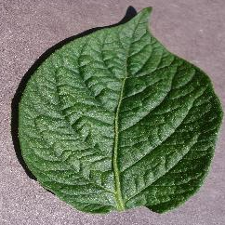
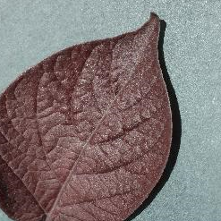
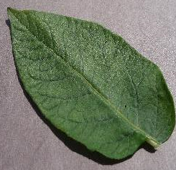
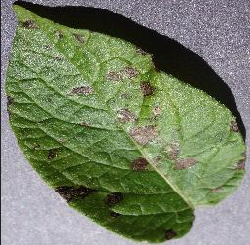
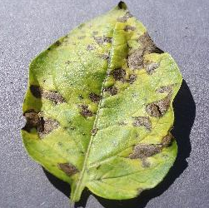
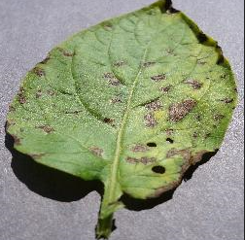
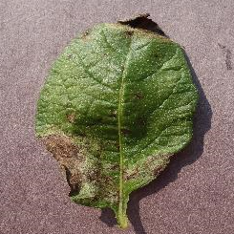
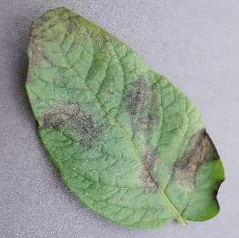
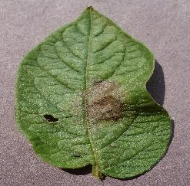
Data Exploration and Preprocessing
Effect of some diseases on Potato
Healthy:
Early Blight:
Late Blight:

Slide 12
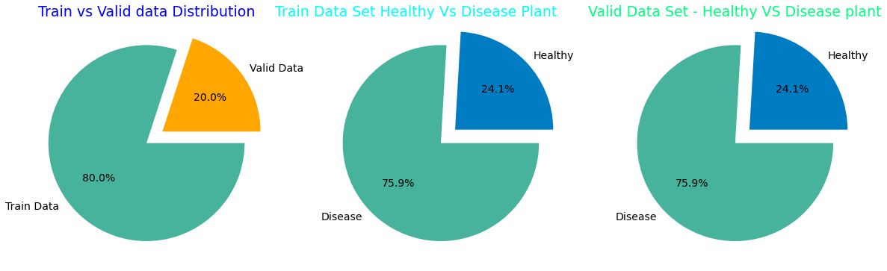
Modelling & Evaluation
We Train Dataset With Two Pretrained Model
1-Resnet50 Model
2-MobileNet Model
By Trying Some Architecture we Created Two CNN Model From Scratch To get high accuracy and stability in model

Slide 13
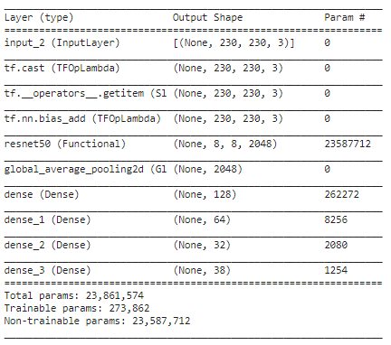
Modelling & Evaluation
Summary Of Model 1 Resnet50

Slide 14
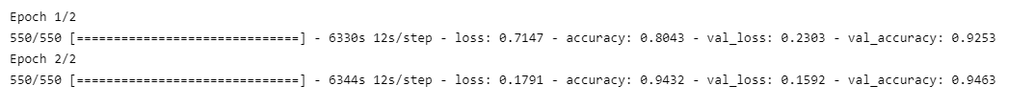
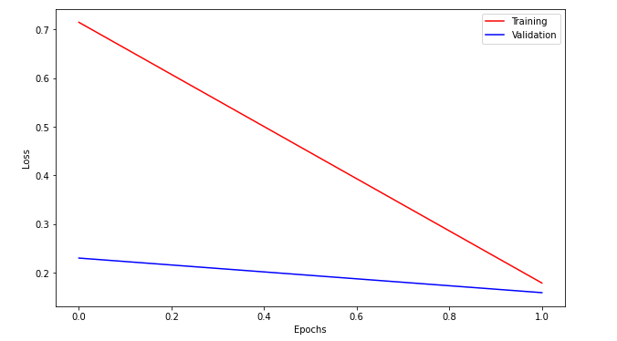
Modelling & Evaluation
Evaluation Of Model 1 Resnet 50

Slide 15
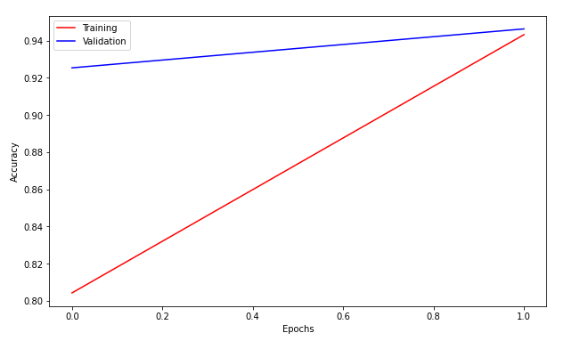
Modelling & Evaluation
Evaluation Of Model 1 Resnet50

Slide 16
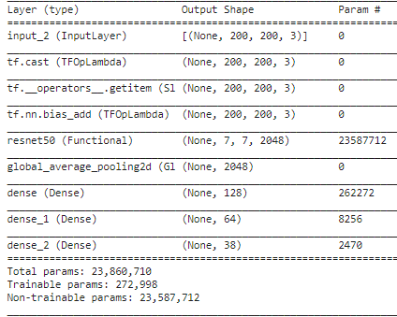
Modelling & Evaluation
Summary Of Model 2 Resnet50

Slide 17
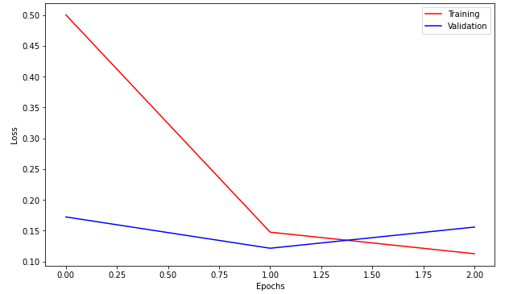
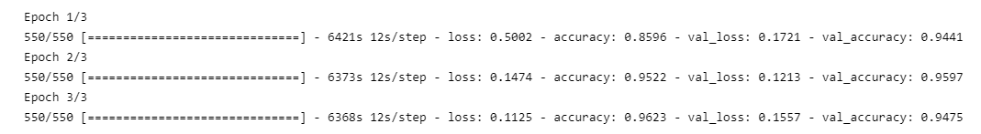
Modelling & Evaluation
Evaluation Of Model 2 Resnet 50

Slide 18
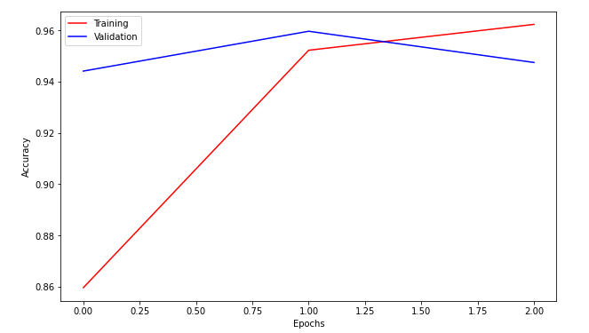
Modelling & Evaluation
Evaluation Of Model 2 Resnet 50

Slide 19
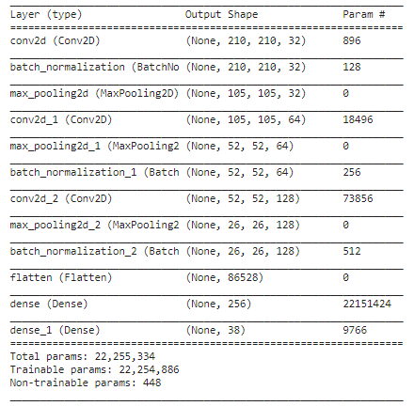
Modelling & Evaluation
Summary Of Our Model 3

Slide 20
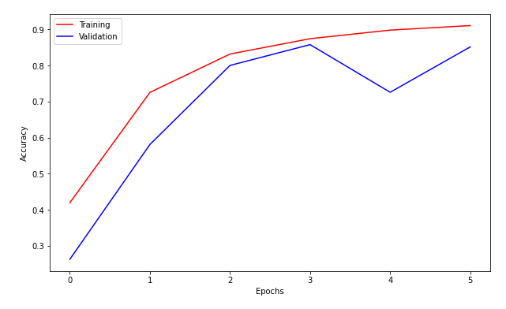
Evaluation Of Our Model 3

Slide 21
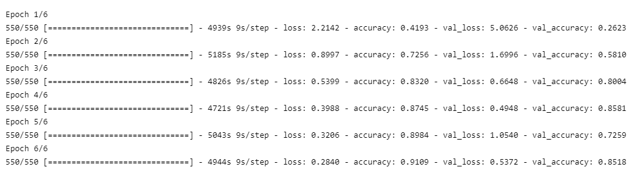
Modelling & Evaluation
Evaluation Of Our Model 3

Slide 22
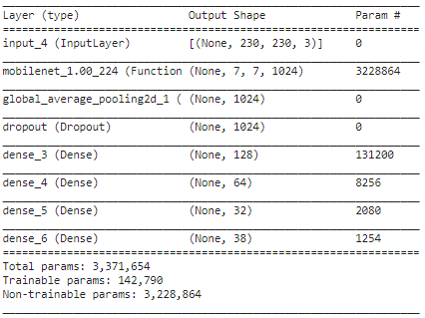
Modelling & Evaluation
Summary Of Model 4 Mobilenet

Slide 23
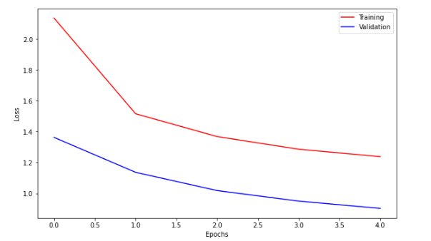
Modelling & Evaluation
Evaluation Of Model 4 Mobilenet

Slide 24
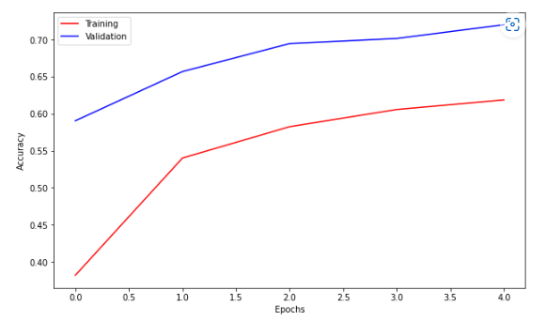
Modelling & Evaluation
Evaluation Of Model 4 Mobilenet

Slide 25
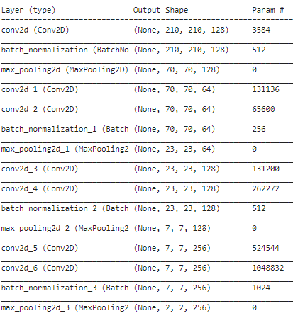
Modelling & Evaluation
Summary Of Our Model 5

Slide 26
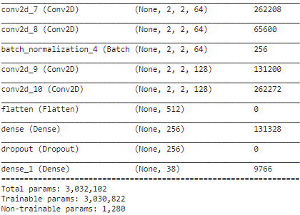
Modelling & Evaluation
Summary Of Our Model 5

Slide 27
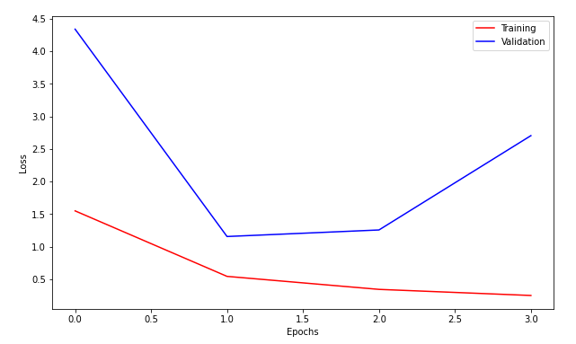
Modelling & Evaluation
Evaluation Of Our Model 5

Slide 28
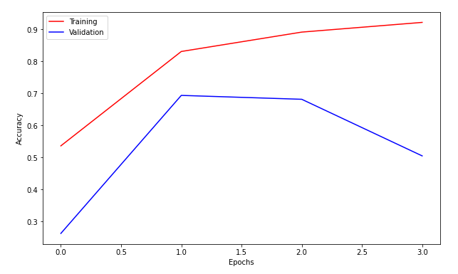
Modelling & Evaluation
Evaluation Of Our Model 5

Slide 29
Problem and Solution
Methods of Controlling Plant Diseases:
Site selection :
A home garden site should be well drained. Avoid wet and poorly drained soils. Excessive soil moisture will favor root and crown diseases such as damping-off as well as crown and root rots caused by fungal soilborne pathogens. Most vegetables require full sunlight for maximum yield and drying of the foliage.
Diseases Free Seed and Transplants :
Many plant diseases can be seed-borne. Do not save seeds from year to year. This is important to prevent a number of diseases, including halo blight, common blight, anthracnose of snap beans, and bacterial
Crop rotation :
Continuous plantings of vegetables within the same plant family provide opportunities for pathogen buildup. Do not plant the same family of vegetable in the same areas year after year. Grow the same plants or closely related plants in the same soil only once every 3 to 5 years. This practice starves out most pathogens that cause stem and leaf diseases.
Sanitation :
After harvest, remove and destroy plant material. Plow the soil to help break down debris that may harbor nematodes, fungi, and bacteria. Plant refuse may also be plowed under. Remove diseased plants, plant residue, and weeds in and around the vegetable garden to reduce the occurrence of some diseases.

Slide 30
Problem and Solution
Methods of Controlling Plant Diseases:
Use a Mulch Layer :
Mulching prevents soil from splashing onto plants and also fruit from touching the bare ground. This will help prevent rots on mature fruit. Mulches also are a sound cultural practice to help conserve soil moisture and reduce weed infestations.
Proper Spacing and Trellising :
Space plants properly to allow growth and air circulation. Staking or trellising prevents soil contact with the foliage and fruit, reducing the incidence of diseases such as fruit rots. Trellising also promotes foliage drying, discouraging the growth of pathogens
Avoid Tobacco When Working in the Garden :
If you use tobacco, wash your hands thoroughly before handling plants. This practice will prevent the spread of tobacco mosaic virus, which can infect many different kinds of vegetables, particularly solanaceous crops (plants related to the nightshade family) such as tomatoes and peppers.
Trap Crops :
Using trap crops helps manage virus diseases and aphid populations. A few rows of a trap crop (such as rye or corn) around the vegetable garden will cause aphids to feed there first, possibly loosening the virus they may carry. Trap crops can limit aphid damage and help reduce the incidence of virus diseases.

Slide 31
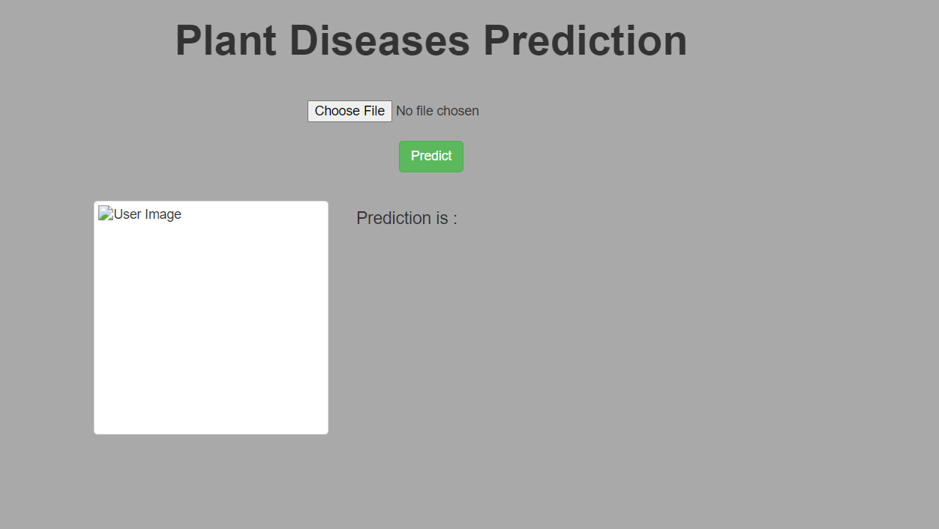
Deployment
Check Our Website that has been made using frontend development for Plant Disease Detection

Slide 32
Thank you!
If you have any questions , Please don’t hesitate we would love to hear your honest opinion.

